Slide 1
G-DLD in AWS cloud platform
For serverless applications
Model

Slide 2
Method Model - Features
Year | Month | Day | Hour | Minute | Second | Millisecond
Chronological features
roleName | targetName | targetType
Objects context features
operationUsed | readOnly | Change_s3 | Change_DynamoDB | Remove_policy | anomaly
Permission features

Slide 3
Model Architecture
Label Encoder
Isolation Forest
Decision Function

Slide 4
Dataset
The number of records in the training dataset is 15113
The number of records in the test dataset is 3779

Slide 5
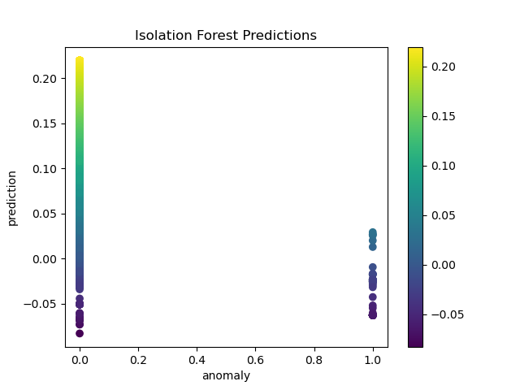
Model
The graph represents the anomaly score for each of the operations.
Closer to 1 is more anomalous, and 0.5 is normal.
The quantile is 0.01

Slide 6
Challenges
Finding a specific attack in the data may prove to be , as there are many ways to the same goal, and many goals that achieve .

Slide 7
Expected Results
The model highlight the anomaly actions.
We would be able to differentiate roles by time-specific changes and check for anomalous permission changes.

